Slide 1
Bitwise operations, Recursion And Why C++ not OOP mainly/only

Slide 2
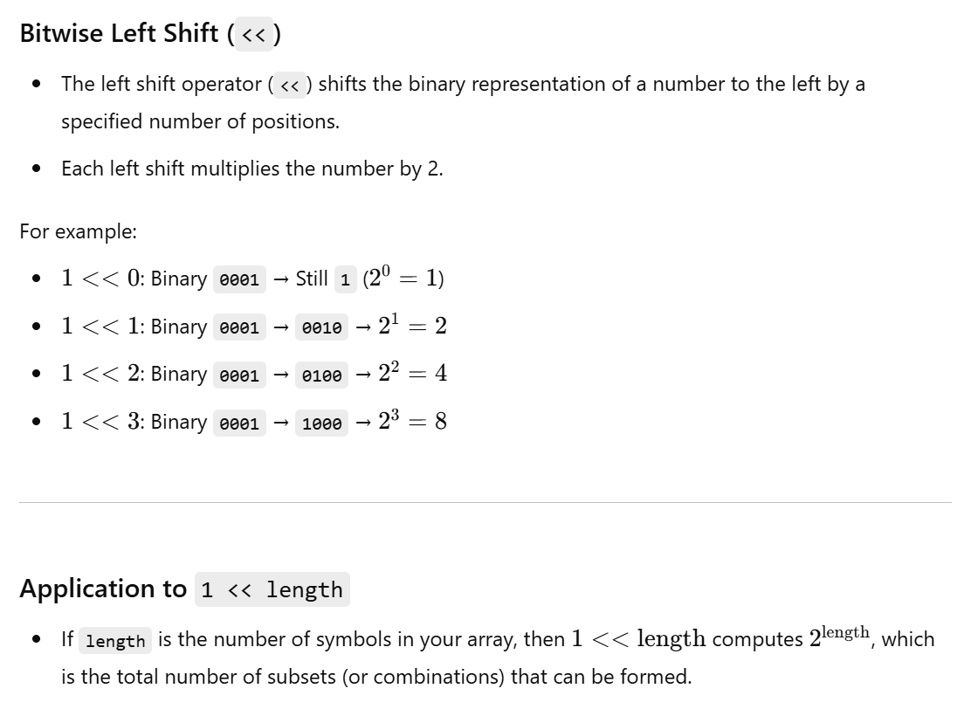

Slide 3
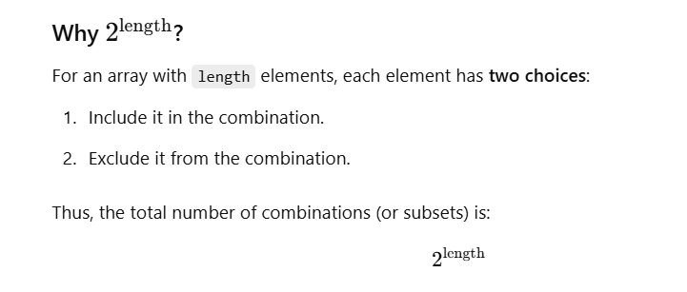

Slide 4
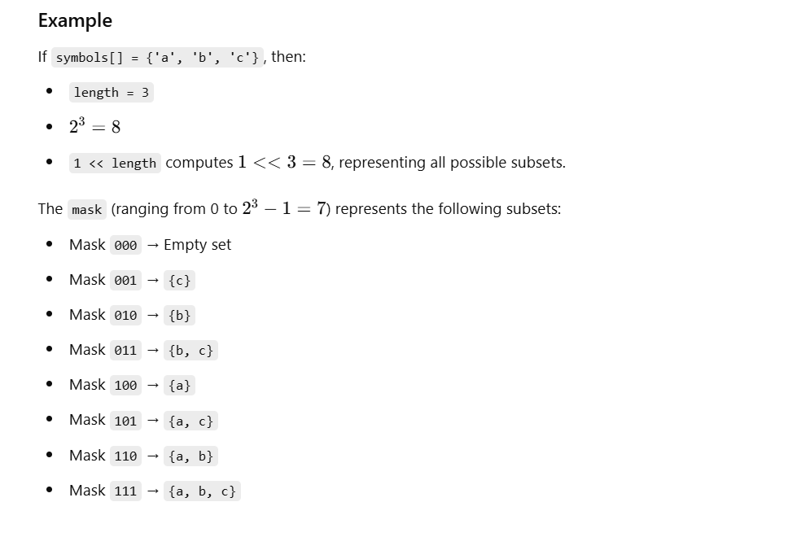

Slide 5
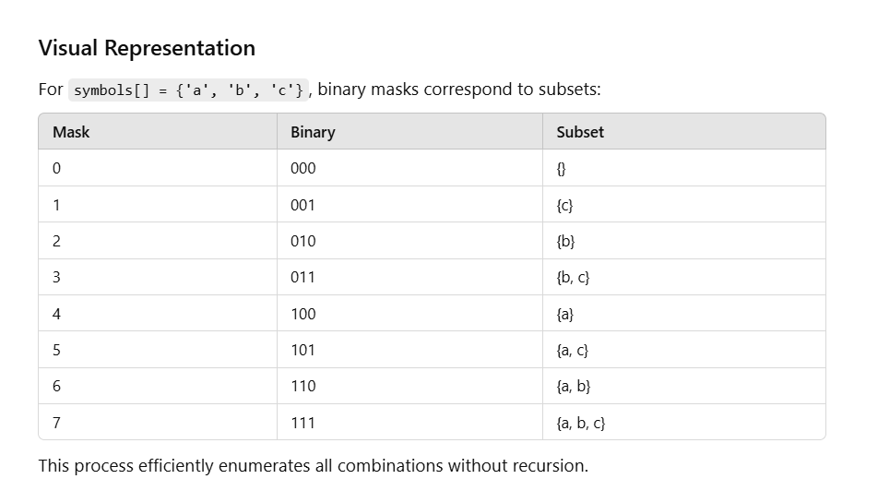

Slide 6
#include <iostream>
#include <vector>
void bruteForce() { char symbols[] = {'a', 'b', 'c'}; // Input symbols int length = sizeof(symbols) / sizeof(symbols[0]); int totalCombinations = 1 << length; // Total combinations = 2^length // Iterate through all possible bit masks for (int mask = 1; mask < totalCombinations; ++mask) { // Start from 1 to skip empty set std::string combination; for (int i = 0; i < length; ++i) { if (mask & (1 << i)) { // Check if the ith bit is set combination += symbols[i]; } } std::cout << combination << "\n"; } } int main() { bruteForce(); return 0; }

Slide 7
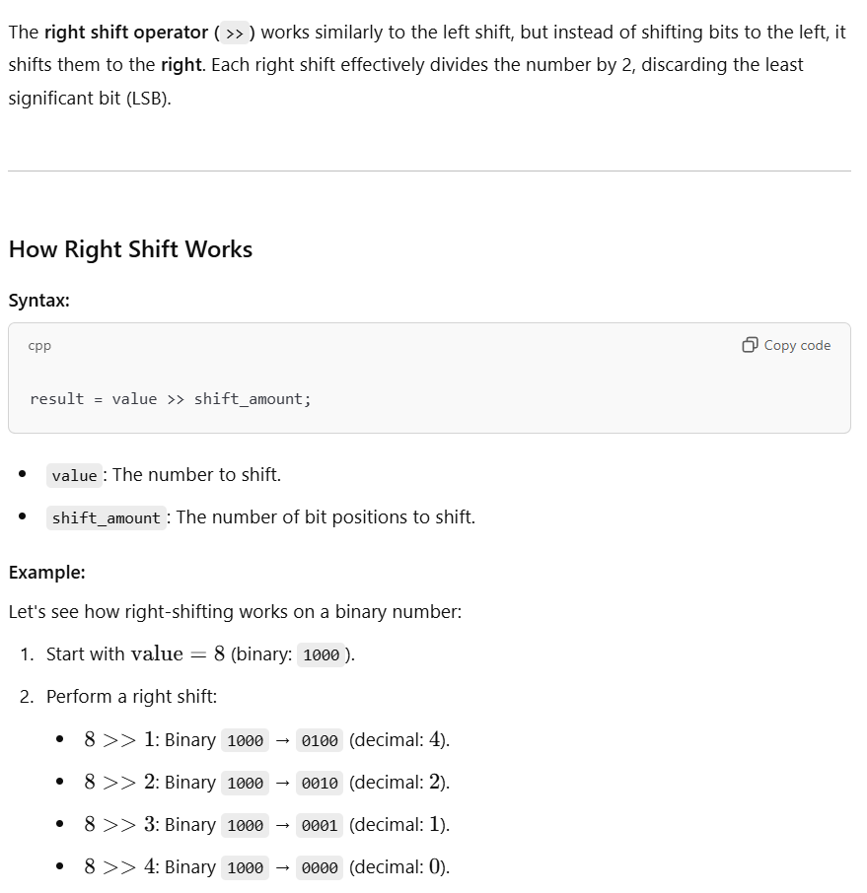

Slide 8
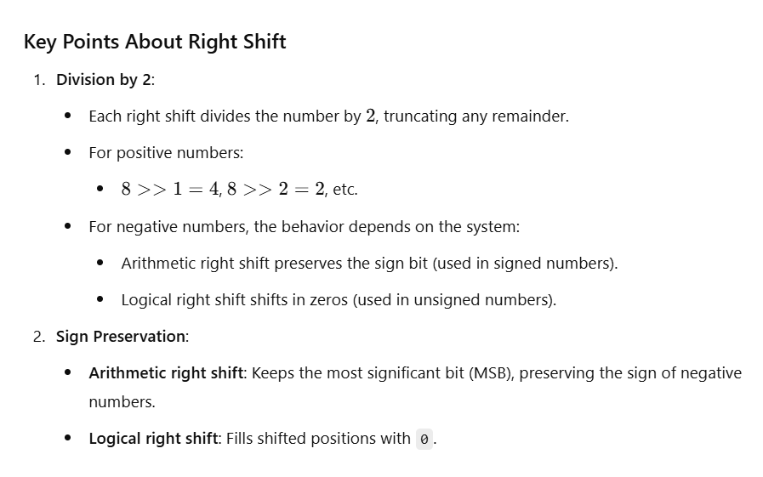

Slide 9
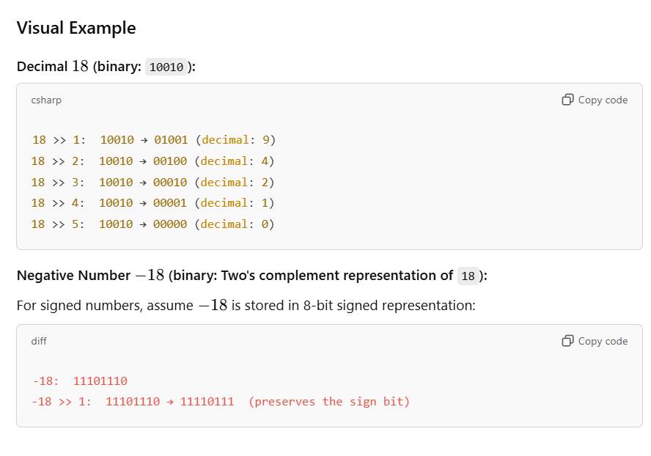

Slide 10
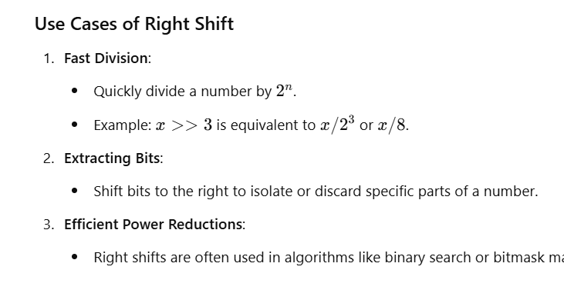

Slide 11
Code Example of Right Shift
#include <iostream>
int main() {
int num = 18; // Start with a positive number
for (int i = 0; i < 5; ++i) {
std::cout << num << " >> " << i << " = " << (num >> i) << "\n";
}
int negNum = -18; // Negative number example
for (int i = 0; i < 5; ++i) {
std::cout << negNum << " >> " << i << " = " << (negNum >> i) << "\n";
}
return 0;
}

Slide 12
